Slide 1
Intro to Data Mining Kaggle Presentation
Younas Mahmood 22854

Slide 2
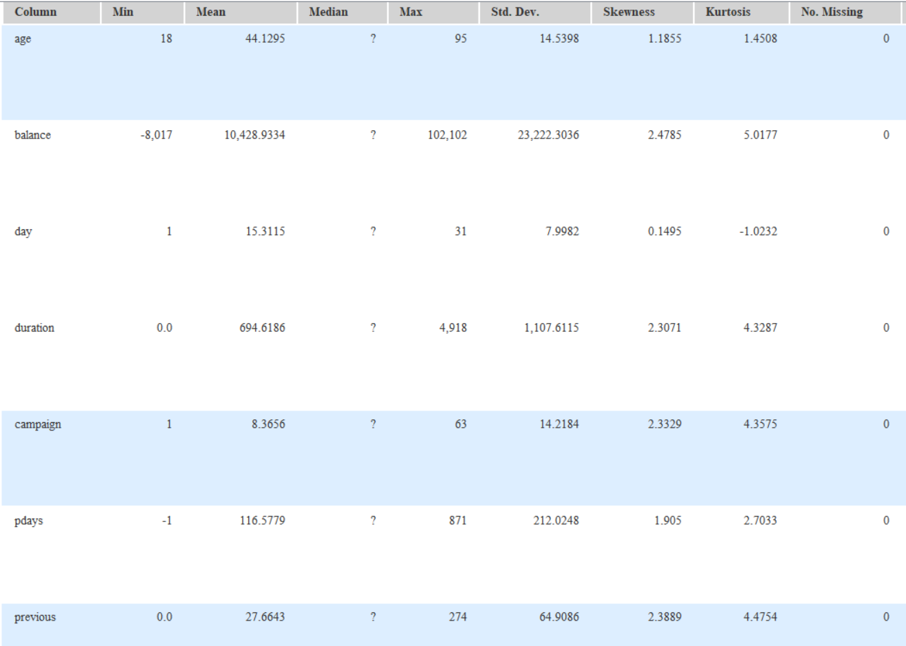
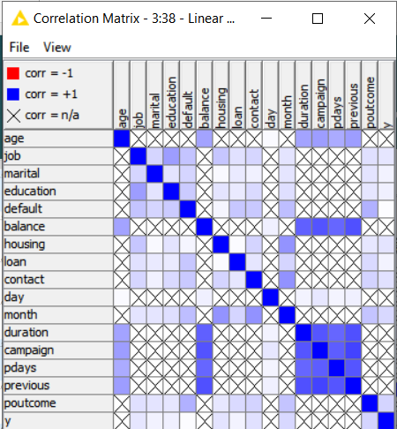
Data Understanding
Using Statistics Node, I understood that the age column histogram had a lot of variance from the min age of 18 and max age of 95. This was good information for me to make categories of ages.
Through Linear correlation node, I understood that the columns most correlated to probability ‘y’ were ‘job’, ‘marital’, ‘education’, ‘default’, ‘housing’, ‘loan’, ‘contact’, ‘month’, ‘poutcome’.

Slide 3
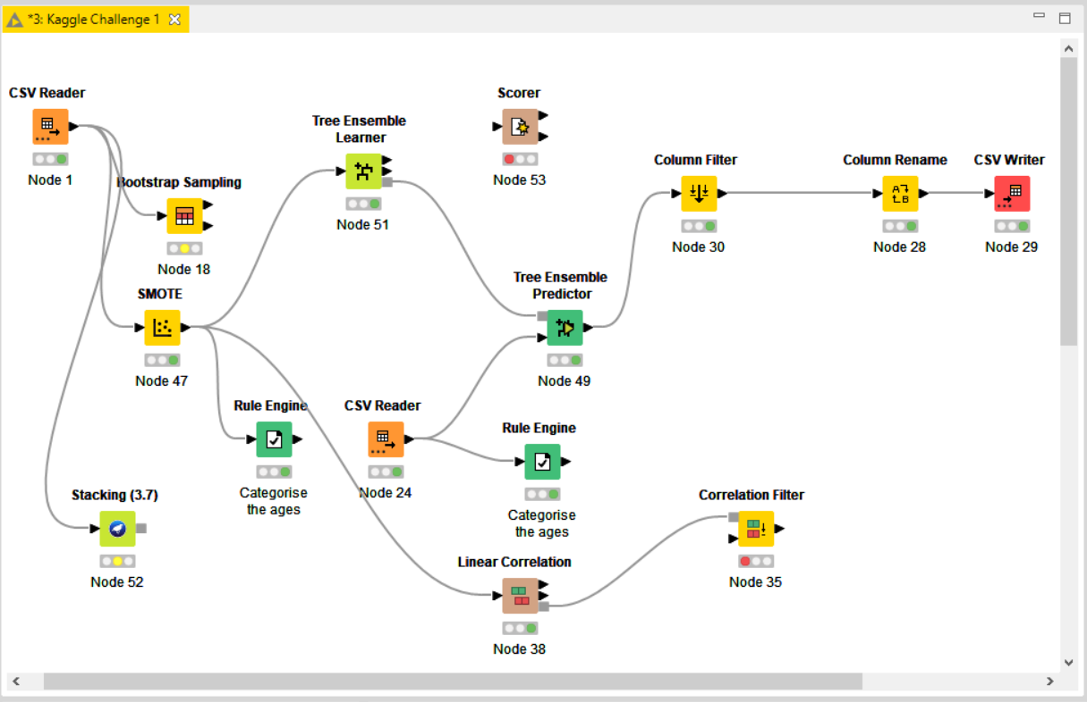
Explaining Work Flow

Slide 4
Explaining Work Flow (2)
Data Preparation:-
For reading the ‘Training set’ and ‘Test set’, I used ‘CSV Reader’.
For increasing the rows of the training set from 60,000 to 300,000+ rows, I used 2 sampling methods. 1) Bootstrap Sampling, by which it resamples dataset many times. 2) SMOTE (Synthetic Minority Over-Sampling Technique), by which it increases number of rows in a balanced way.
I used ‘Rule Engine’ for some entries to categorise or bin the ‘Age’ column of training set into (Teens, Young Adults, Seniors).
I used ‘Linear Correlation’ for some entries to know which columns most positively impacted the probability ‘y’, and then filtered them through ‘Correlation Filter’ node.
There were no missing values in data set.
Modeling:-
I used a variety of models such as Random Forest, Tree Ensemble, Decision Tree, Naïve Bayes, Gradient Boosted Trees, Stacking. Out of all these models, Tree Ensemble & Random Forest were the best
Increasing the number of models and patterns to learn, increased the accuracy but slowed down processing time
Best split criterion was ‘Information gain’ amongst all criterions
Using different random seeds also improved the accuracy sometimes
Evaluation:-
Sometimes, I tested different conditions of models by bootstrap sampling or partitioning the training set, and checking the accuracy using the ‘Scorer’ node.
Mostly, I used the Kaggle scoring system to evaluate if the given entry was better than the last.

Slide 5
Entry | Pre-processing techniques | Model configurations | Kaggle Score (%) | Understanding
1 | None | Random Forest Method | 0.08136 | The wrong column (p(y=no)) was the result
2 | None | Random Forest Method | 0.91863 (PB) | Corrected column
3 | None | Random Forest Method | 0.91863 | Did not execute csv writer
4 | None | Tree Ensemble Method, Tree depth limited to 8 | 0.88091 | Default Conditions
5 | Bootstrap Sampling used | Random Forest Method | 0.82067 | Sample size was 100% resulting in valuable rows being left in holdout samples
6 | Removed Column ‘Day’ from data | Random Forest Method | 0.91579 | Column ‘day’ was important for probability of ‘y’
7 | Removed Column ‘Age’ from data | Random Forest Method (Number of models increased to 150) | 0.91604 | Column ‘Age’ was important for probability of ‘y’
8 | None | Random Forest Method (Number of models increased to 200) | 0.92046 (PB) | Increasing models, increased accuracy. New personal best
9 | None | Decision Tree, Quality measure (gain ratio), pruning method (MDL), reduced error pruning, minimum number records per node (10), number of records store for view (30,000), number threads (4) | 0.85790 | Decision Tree isn’t better than Random Forest Model
10 | None | Naïve Bayes | 0.72732 | Default Conditions

Slide 6
Entry | Pre-processing techniques | Model configurations | Kaggle Score (%) | Understanding
11 | None | Gradient Boosted Trees, Tree depth 4, number of models 3000, learning rate 0.05 | 0.89826 | Random Forest was giving better score, tree depth may be low
12 | None | Random Forest Method, split criterion GINI index, limit tree depth to 12, number of models 500 | 0.90088 | GINI index isn’t better than Information Gain Ratio
13 | Bootstrap Sampling used with size 500% | Random Forest Method, 3000 patterns learnt, 300 number of models, split criterion information gain ratio | 0.92444 (PB) | Bootstrap sampling increased rows by 5 times and random forest patterns, models increased accuracy.
14 | Bootstrap Sampling used with size 500% | Random Forest Method, patterns stored 3100, 300 number of models, split criterion information gain. | 0.92605 (PB) | Split criterion information gain better than information gain ratio
15 | Bootstrap Sampling used with size 500% | Random Forest Method, patterns stored 3500, 300 number of models, split criterion information gain, Tree depth 15 | 0.91102 | Tree depth was too less & reduced accuracy
16 | Bootstrap Sampling used with size 500% | Random Forest Method, patterns stored 3500, number of models 320, split criterion information gain. Tree depth not limited, did not use static random seed | 0.92601 | Removing static random seed, decreased the score.
17 | Bootstrap sampling used with size 500% | Random Forest Method, patterns stored 3500, number of models 320, split criterion information gain. Tree depth not limited, used static random seed | 0.92609 (PB) | Static random seed, increased the score

Slide 7
Entry | Pre-processing technniques | Model configurations | Kaggle Score (%) | Understanding
18 | Bootstrap Sampling, size 700% | Random Forest Method, patterns stored 3500, models 350, split criterion information gain, tree depth not limited, used static random seed | 0.92737 (PB) | Increasing sample size, patterns stored, models, increased accuracy
19 | Bootstrap sampling, size 700% | Random Forest Method, patterns stored 3500, models 350, split criterion information gain, tree depth not limited | 0.92733 | Removing static random seed, decreased accuracy
20 | Bootstrap Sampling used with size 1000% | Random Forest Method, 3500 patterns stored, 500 number of models, split criterion information gain, tree depth not limited | 0.92744 (PB) | Increasing number of models, increased accuracy
21 | Bootstrap Sampling used with size 1000% | Tree Ensemble Method, patterns stored 3100, 500 number of models, split criterion information gain. | 0.92646 | Patterns stored were less than before, accuracy less
22 | Bootstrap sampling, size 1000% without static random seed | Random Forest Method, patterns stored 3800, models 300, split criterion information gain, tree depth not limited | 0.92606 | Number of models were less than before, accuracy less
23 | Bootstrap sampling, 1000% without static random seed | Random Forest Method, patterns stored 3650, models 530, split criterion information gain, tree depth not limited | 0.92761 (PB) | Increasing number of patterns & models than last best accuracy
24 | Rule engine to make five categories of age, with bootstrap sampling size 1200%. No seed. Used domain calculator because of number to string | Random Forest Method, 3650 patterns stored, 530 models, split criterion information gain, tree depth not limited | 0.92573 | Making categories of age(kid, teen, young adult, middle aged, senior) did not improve accuracy

Slide 8
Entry | Pre-processing techniques | Model configurations | Kaggle Score(%) | Understanding
25 | Engine rule to make 5 categories, bootstrap sampling with size 1200%, without static random seed, used domain calculator because of number to string | Random Forest Method, 3650 patterns stored, 530 models, split criterion information gain, tree depth not limited | 0.92573 | Changing of ages in categories did not improve the score
26 | Engine rule to make 3 categories, bootstrap sampling size 1200% without static random seed, used domain calculator because of number to string | Random Forest Method, 3650 patterns stored, 530 models, split criterion information gain, tree depth not limited | 0.92584 | Changing categories into (Teen, Young Adult, Senior). Improved score marginally
27 | Engine rule to make 3 categories, bootstrap sampling size 1200% without static random seed, used domain calculator because of number to string | Random Forest Method, 3850 patterns stored, 530 models, split criterion information gain, tree depth not limited | 0.92587 | Increasing number of patterns, improved score
28 | Engine rule to make 3 categories, bootstrap sampling size 1200% without static random seed, used domain calculator because of number to string | Random Forest Method, 3850 patterns stored, 530 models, split criterion information gain, tree depth not limited | 0.92700 | This time I had also made 3 categories of ‘Age’ for the ‘Test Set’ as well. Which improved the score
29 | Engine rule to make 3 categories, bootstrap sampling size 1200% without seed. | Random Forest Method, 3950 patterns stored, 500 models, split criterion information gain, tree depth not limited | 0.92655 | Removing domain calculator, decreased score since domain calculator stops restricting values.
30 | Used rule engine to make 3 categories, then used shuffle | Random Forest Method, 3950 patterns, 500 models, split criterion information gain, tree depth not limited | 0.92267 | Removing bootstrap reduced the number of rows massively. Hence, score decreased.

Slide 9
Entry | Pre-processing techniques | Model configurations | Kaggle Score(%) | Understanding
31 | None | Tree Ensemble, models 530, patterns stored 3850, split criterion information gain | 0.92301 | Tree Ensemble was giving as good of a score as random forest
32 | None | Tree Ensemble, models 530, patterns stored 3850, used static random seed split criterion information gain ratio | 0.92023 | Information gain is better than information gain ratio. Hence, score decreased
33 | None | Tree Ensemble, tree depth not limited | 0.92761 | Tree Ensemble better than Random Forest in default conditions
34 | SMOTE (3 nearest neighbour & over sample by 7), seed drawn 460385029409684691 | Tree Ensemble, number of models 200, split criterion information gain, patterns stored 3900, static random seed of model -9022717391398165101 | 0.92814 (PB) | SMOTE oversamples input data and enriches the training set by adding synthetic rows which are similar to the real rows by extrapolating from them and it’s neighbours
35 | SMOTE (3 nearest neighbour & over sample by 7), seed drawn 460385029409684691 | Tree Ensemble, number of models 500, split criterion information gain, patterns stored 3900, static random seed of model -9022717391398165101 | 0.92875 (CB) | Increased number of models to 500 which increased score
36 | SMOTE (3 nearest neighbour & over sample by 7), seed drawn 460385029409684691 | Tree Ensemble, number of models 510, split criterion information gain, patterns stored 3900, static random seed of model -9022717391398165101 | 0.92879 (CB) | Increased number of models to 510 which increased score

Slide 10
Entry | Pre-processing techniques | Model configurations | Kaggle Score(%) | Understanding
37 | SMOTE (3 nearest neighbour & over sample by 7), seed drawn 460385029409684691 | Tree Ensemble, number of models 520, split criterion information gain, patterns stored 4000, static random seed of model -9022717391398165101 | 0.92883 (CB) | Increased models to 520, patterns stored to 4000. Improving the score.
38 | SMOTE (3 nearest neighbour & over sample by 7), seed drawn 460385029409684691 | Tree Ensemble, number of models 530, split criterion information gain, patterns stored 4000, static random seed of model -9022717391398165101 | 0.92878 | Increased models to 530, decreased score. Probably because needed more patterns stored or models weren’t as good as last entry
39 | None | Stacking, number execution slot 1, number of folds 200, seed 1, meta classifier ZeroR | 0.50000 | Stacking model default conditions resulted in a bad accuracy
40 | SMOTE (3 nearest neighbour & over sample by 7), seed drawn 460385029409684691 | Tree Ensemble, number of models 520, split criterion information gain, patterns stored 4100, static random seed of model -9022717391398165101 | 0.92883 (CB) | Increased patterns to 4100, no change in best score.
41 | SMOTE (5 nearest neighbour & over sample by 7), seed drawn 460385029409684691 | Tree Ensemble, number of models 520, split criterion information gain, patterns stored 4500, static random seed of model -9022717391398165101 | 0.93156 (CB) | Increased patterns to 4500 & SMOTE used for 5 nearest neighbours, score increased a lot
42 | SMOTE (5 nearest neighbour & over sample by 7), seed drawn 460385029409684691 | Tree Ensemble, number of models 520, split criterion information gain, patterns stored 4800, static random seed of model -9022717391398165101 | 0.93156 (CB) | Increased patterns to 4800, but score remained the same

Slide 11
Entry | Pre-processing techniques | Model configurations | Kaggle Score(%) | Understanding
43 | I used rule engine to make 3 categories of ‘Age’ and then used SMOTE (5 nearest neighbour & over sample by 7) on training set, seed drawn 460385029409684691 | Tree Ensemble, number of models 520, split criterion information gain, patterns stored 4900, static random seed of model -9022717391398165101 | 0.93042 | Categories of age did not improve the score.
44 | SMOTE (21 nearest neighbour & over sample by 7) on training set, seed drawn 460385029409684691 | Tree Ensemble, number of models 520, split criterion information gain, patterns stored 4900, static random seed of model -9022717391398165101 | 0.93247 (PB) | Increasing nearest neighbours increased the score, but I think 21 nearest neighbours were far too much and resulted in overfitting.
45 | SMOTE (10 nearest neighbour & oversample minority classes) on training set, seed drawn 460385029409684691 | Tree Ensemble, number of models 520, split criterion information gain, patterns stored 5200, static random seed of model -9022717391398165101 | 0.92430 | Oversampling the minority classes was not useful for improving the score.
PB = Personal Best | CB = Competition Best (At the time entered)

Slide 12
Overall findings & insights
The best model for the dataset for me was definitely ‘Tree Ensemble’, because with continuous values it doesn’t lose necessary information. Tree ensemble also had more configurations options than ‘Random Forest’ such as midpoint splits. Naïve Bayes worked better with categorical data compared to continuous values.
The best split criterion for the dataset was definitely ‘information gain’.
Transformation techniques of column such as ‘SMOTE’ increased the score massively, and transformation technique of rows such as ‘Bootstrap Sampling’ also improved the score. I also used ‘Linear Correlation’, but that wasn’t as helpful for improving the score as the models were losing necessary information.
The challenges I faced were finding the best model for the score, which I found out through trial and error. After finding the best model, I then started finding the best configurations of that model to improve the score. After research about the best sampling techniques, and also through trial and error, I found out the best sampling technique ‘SMOTE’ which made my score the best at the time I entered it.

